Slide 1
webOS multimedia framework Performance Enhancement

Slide 2
SW Architecture 과제계획서
① 작성자 | 소속 : SWP연구소 CPS팀 |  | 강명헌 수석
② 작성일 | 2014년 7 월 1 일 | 인증연도 |  | 2012년
③ 과제명 | webOS multimedia framework Performance Enhancement
④ 과제분류* | 2.AD Architecture Design
⑤ 수행 기간 | 2014년 4 월 1 일 ~ 2014년 11 월 29 일
⑨ 참여 인원 & R&R | Architecture Design : 강명헌 Developer : 최혜진, Kiran
⑥ 추진배경 / 요구사항정의 | Power Consumption Player and Audio Server Design aligned with Power 중앙 시스템에서의 Power Monitoring 및 측정 복잡한 Power 요소 및 Control 필요함. 최대 Performance 를 유지하면서 Power 감소 User is sure to feel music audio delay to pop out Time latency decrease. Runtime Memory Manage, CPU Management
⑦ 과제 목표 | Low Power and Time Latency Enhancement Low Power Player Design Low Power Audio Server Design Wearable Customization
⑧ 기대 효과 | Power Consumption Less than 20mA competitive to Android No audio drop and glitch Time Latency Less than 700msec from input through kernel device open No user awareness of delay
⑩ 추진 세부 일정
⑪ 산출물 (제출용) | SW Architecture Design 문서
⑫ 검증 방법 | 구현된 Power Management를 적용하여 시스템 검증 Time Latency 측정을 통한 before and After 비교 Power 측정을 통한 before and After 비교
⑬ 지원 요청 사항 | 없음
4월
5월
9월
11월
요구사항 분석
Architecture Design
구현 및 테스트
Notes:
상세 과제 계획서에 대해서는 별도의 포멧이 있기 보다는 필요에 따라 3장 이내로 작성하여 제출 가능한 것으로 하면 될 것 같습니다.

Slide 3
Intro
Terms and Abbreviations
LPA | Low Power Audio
DOU | Daily Of Usage
GStreamer | is the open source, pipeline-based multimedia framework
OpenMax | is the standard API to interface multimedia processing
Audio Server | is to route audio stream to the physical devices, aka PulseAudio for webOS
Audio DSP | is the audio processor to mix and route audio streams in physical
Audio Decoder | is dedicated to decode audio encoded
uMediaServer | manages multiple playbacks requested by applications
Resource Manager | allocates hardware resources to player

Slide 4
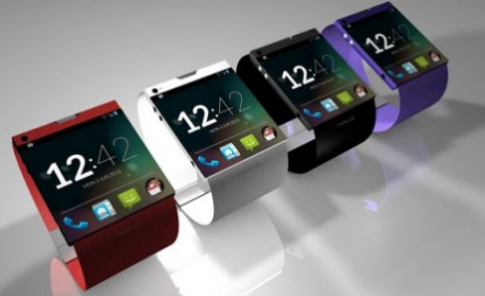

1. Project Overview
Goal
To launch wearable watch device over webOS
To meet power consumption constraint against music playback ➔
To achieve short time latency to pop music out ➔
Low power audio system
Low latency audio player
Notes:
15년 3월초를 목표를 개발중이며, 인도인원으로 개발팀이 만들어지게 됩니다.

Slide 5
1. Project Overview
webOS Media Framework
Web-friendly media server
GStreamer multimedia framework
webOS
Android
Application
Application
uMediaServer
uMediaServer
MediaPlayerService
Starfish media pipeline
Player
Stagefright
GStreamer
Multimedia Framework
OpenMax
(Vender Specific)
OpenMax IL Component
OpenMax IL Component
Component
Component
Codec
(Vender Specific )
Codec
Codec
Notes:
Open API는 크로녹스 그룹이 배포한 명세에 대한 Wrap API만을 제공한다.
Body는 Vender가 알아서

Slide 6
1. Project Overview
webOS Audio Framework
Audio Policy Manager
Audio Server ( PulseAudio vs. Audio Flinger )
webOS <mobile>
Android
Application
Application
Audio Policy Manager
AudioD
Audio Policy
Audio Server
PulseAudio
Audio Flinger
ALSA
TinyALSA
TinyALSA
HW Driver
Audio DSP
Audio DSP
Notes:
Open API는 크로녹스 그룹이 배포한 명세에 대한 Wrap API만을 제공한다.
Body는 Vender가 알아서

Slide 7
1. Project Overview
webOS Media/Audio Architecture
Media Player feeds decoded stream (PCM) and encoded stream both
Audio Policy manages sound profiles ( ex Sound, Silent,…)
Audio Policy manages volume policy against input streams ( ex media, phone, touch, tts,…)
Audio Policy manages module (ex Phone) and scenario (ex BT device)
Audio Server set mixer enable/disable and open to feed input streams HW device. < route, ALSA UCM>
Web Application
WebKit
WebKit MediaPlayer
WebKit MediaPlayer
AudioD
Audio Policy Manager
uMediaServer
uMediaServer
Modules & Scenarios
Pipeline
Manager
Resource Manager
Starfish media pipeline
Media Player
Encoded
Stream
Audio Server
Audio Flinger
Gstreamer
PulseAudio
PCM
Stream
ALSA
Hardware driver
Audio Decoder
Audio DSP
Hardware driver
Decoding Processor

Slide 8
1. Project Overview
Deliverable
MP3 playback over BT <NonTunnel>
MP3 playback over Speaker <Tunnel>
Startup Latency decreases around 800msec
Power Consumption decreases down to 28.57mA (+0.57mA compared to Android) over BT
Total is 58mA, MP3 only is 28mA.
Time Latency
Power Consumption
2.7sec
135mA(65mA)
1.6sec
105mA(43mA)
0.95sec
89mA(37mA)
0.85sec
72mA(28.57mA)
gStreamer
Customization
JUN
JUL
AUG
SEP
SEP 14th
OCT 22th
OCT 29th
NOV 15th
NOV30th
2 Pipeline
Player
LPA
Applied
PA 5.0
Applied
1 Pipeline
Player
MP3
Consume
Task
Interim
#1
Interim
#2
Final
Initial

Slide 9
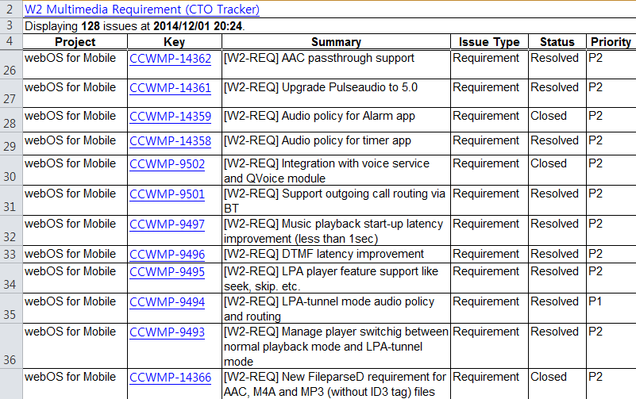
2. Architectural Drivers
Functional Requirements
128 functional features
http://collab.lge.com/main/download/attachments/198476541/WebOS+Wearable+Multimedia+Requirement.xls
Notes:
Open API는 크로녹스 그룹이 배포한 명세에 대한 Wrap API만을 제공한다.
Body는 Vender가 알아서

Slide 10
2. Architectural Drivers
Constraints
Business
Achieve the higher performance requirements compared to android gear
Technical
webOS on ARM v7 with Qualcomm 8x26 SOC
C/C++, json, python
Time latency less than 1sec to pop out audio is required
Power consumption less then 38 mA to consume is required.
Notes:
Open API는 크로녹스 그룹이 배포한 명세에 대한 Wrap API만을 제공한다.
Body는 Vender가 알아서

Slide 11
2. Architectural Drivers
Quality Attributes
Performance
LPA module should meet the power consumption less than 20mA proposed by LG MC division.
ID | QA001
Raw Quality Attribute | LPA Performance
Stimulus | Application send the event to start song playback
Source(s) of the stimulus | Applications
Environment | Application initiate to start the playback
Artifact Stimulated | LPA Player
System Response | LPA Player shows its consuming power level via Bluetooth device and speaker
Response Measure(s) | Check whether power consumption is less than 28mA
Notes:
Open API는 크로녹스 그룹이 배포한 명세에 대한 Wrap API만을 제공한다.
Body는 Vender가 알아서

Slide 12
2. Architectural Drivers
Quality Attributes
Responsibility
LPA player should pop out audio less than 700ms proposed by MC LG.
ID | QA002
Raw Quality Attribute | LPA Responsibility
Stimulus | Application send the event to start song playback
Source(s) of the stimulus | Applications
Environment | Application initiate to start the playback
Artifact Stimulated | LPA Player
System Response | LPA Player responses to pop out audio via speaker or Bluetooth device
Response Measure(s) | Check whether audio latency to pop out audio is less than 700ms
Notes:
Open API는 크로녹스 그룹이 배포한 명세에 대한 Wrap API만을 제공한다.
Body는 Vender가 알아서

Slide 13
2. Architectural Drivers
Quality Attributes
Portability
LPA module should be ported on the any Qualcomm SOC Platform
ID | QA003
Raw Quality Attribute | LPA Portability
Stimulus | Port LPA module on webOS with new Qualcomm SOC Platform
Source(s) of the stimulus | New Qualcomm SOC Platform
Environment | new Mobile Product Development based on webOS
Artifact Stimulated | LPA Code
System Response | LPA works well on webOS with new Qualcomm SOC Platform
Response Measure(s) | Available to check whether module itself can be ported on webOS with new Qualcomm SOC Platform without any modification
Notes:
Open API는 크로녹스 그룹이 배포한 명세에 대한 Wrap API만을 제공한다.
Body는 Vender가 알아서

Slide 14
2. Architectural Drivers
Quality Attributes
Availability
LPA module should work even an unexpected faults happens
ID | QA004
Raw Quality Attribute | LPA Availability
Stimulus | Port LPA module on webOS with new Qualcomm SOC Platform
Source(s) of the stimulus | New Qualcomm SOC Platform
Environment | New Mobile Product Development based on webOS
Artifact Stimulated | LPA Code
System Response | LPA works well on webOS with new Qualcomm SOC Platform
Response Measure(s) | check whether module itself can be ported on webOS with new Qualcomm SOC Platform without any modification
Notes:
Open API는 크로녹스 그룹이 배포한 명세에 대한 Wrap API만을 제공한다.
Body는 Vender가 알아서

Slide 15
2. Architectural Drivers
Quality Attributes
Concurrency
LPA player should work in multiple playback instance
LPA player should guarantee concurrency among multiple playbacks
ID | QA005
Raw Quality Attribute | LPA Concurrency
Stimulus | Application send the event to start song playback
Source(s) of the stimulus | Applications
Environment | Application initiate to start the playback
Artifact Stimulated | LPA Player
System Response | LPA Player response to pop out audio via speaker or Bluetooth device
Response Measure(s) | Check whether multiple audio playback work well aligned with Audio Policy
Notes:
Open API는 크로녹스 그룹이 배포한 명세에 대한 Wrap API만을 제공한다.
Body는 Vender가 알아서

Slide 16
2. Architectural Drivers
Quality Attributes Prioritization
ID | Title | Urgency(5) | Difficulty(5) | Evaluation
QA001 | Performance | 5 | 5 | 25
QA002 | Responsibility | 4 | 5 | 20
QA003 | Portability | 5 | 4 | 20
QA004 | Availability | 3 | 4 | 12
QA005 | Concurrency | 3 | 3 | 9
Notes:
Open API는 크로녹스 그룹이 배포한 명세에 대한 Wrap API만을 제공한다.
Body는 Vender가 알아서

Slide 17
3. System Design
webOS Media/Audio Framework for Latency and Power
Media player subscription on BT status
Gstreamer manipulation to feed Compressed and PCM stream.
Pulseaudio upgrade
Pulseaudio support ALSA UCM configuration
Pulseaudio module extension (BSA BT) for NonTunnel mode playback <NonTunnel>
Pulseaudio module extension (compressed stream) for Tunnel mode playback <Tunnel>
WebKit MediaPlayer
Web Application
AudioD
Audio Policy Manager
uMediaServer
uMediaServer
Modules & Scenarios
Pipeline
Manager
Resource Manager
Starfish media pipeline
Media Player
Compressed
Stream
Audio Server
Audio Flinger
Gstreamer
PulseAudio
PCM
Stream
ALSA
Hardware driver
Audio Decoder
Audio DSP
Hardware driver
Decoding Processor

Slide 18
3. System Design
NonTunnel mode
General audio playback mode
Audio streams are decoded and fed into Pulseaudio
Any file playback except MP3 and AAC codec series over Speaker
Any file playback over BT
Web Application
WebKit
WebKit MediaPlayer
WebKit MediaPlayer
uMediaServer
uMediaServer
AudioD
Audio Policy Manager
Pipeline
Manager
Resource Manager
Modules & Scenarios
Starfish media pipeline
Media Player
GStreamer
Audio Server
Audio Flinger
Source
Element
Demux
Element
Decoder
Element
Sink
Element
PulseAudio
PCM
Stream
Hardware driver
File
Audio Decoder
ALSA Sink
Audio DSP
Hardware driver
Notes:
Audio streams are decoded and fed into Sink that conveys those to Audio Server
Audio Server receives encoded PCM stream chunks to mix and route

Slide 19
3. System Design
Tunnel Mode
Sleep <play> , Deep Sleep <pause>
Media player needs to feed compressed stream
Media player and Pulseaudio needs to synchronize playback time
Pulseaudio <compressed sink> feeds the compressed stream into Audio DSP.
Only MP3 and AAC codec series over Speaker
WebKit MediaPlayer
Web Application
WebKit MediaPlayer
uMediaServer
uMediaServer
AudioD
Audio Policy Manager
Pipeline
Manager
Resource Manager
Modules & Scenarios
Starfish media pipeline
Media Player
GStreamer
Audio Server
Audio Flinger
Source
Element
Demux
Element
Sink
Element
PulseAudio
Compressed
Stream
Hardware driver
File
Compressed Sink
Audio DSP
Hardware driver
Decoding Processor

Slide 20
4. Architectural Design
2 Players
Android
When a application starts or when mode change is required
2 Players own GStreamer framework per each
Week point #1 : 2 players spend 1.5 times in memory usage
Week point #2 : Latency over 3 sec to start playback when after touch
Week point #3 : Latency over 2 seconds to start playback when required switching mode
WebKit MediaPlayer
Web Application
WebKit MediaPlayer
AudioD
Audio Policy Manager
uMediaServer
uMediaServer
Modules & Scenarios
Pipeline
Manager
Resource Manager
Players
Media Player
Tunnel
Compressed
Stream
Audio Server
Audio Flinger
Media Player
NonTunnel
PulseAudio
PCM
Stream
Hardware driver
Audio Decoder
Compressed Sink
Audio DSP
Hardware driver
Decoding Processor

Slide 21
4. Architectural Design
Single Player
ipelines
A player is created with 1 pipeline
When mode change required, player finalizes previous one pipeline and set up new one.
Week point #1 Latency over 2 seconds to start playback when required switching mode.
2 GStreamer pipelines
WebKit MediaPlayer
Web Application
WebKit MediaPlayer
AudioD
Audio Policy Manager
uMediaServer
uMediaServer
Modules & Scenarios
Pipeline
Manager
Resource Manager
Player
Media Player
Compressed
Stream
Audio Server
Audio Flinger
Gstreamer Pipeline Tunnel
Gstreamer Pipeline NonTunnel
PulseAudio
PCM
Stream
Hardware driver
Audio Decoder
Compressed Sink
Audio DSP
Hardware driver
Decoding Processor

Slide 22
4. Architectural Design
Single Player
ipelines
A player is created with 1 pipeline
Output selector <Tick mode issue>, Dynamic Linking/Unlinking
Single GStreamer pipelines
WebKit MediaPlayer
Web Application
WebKit MediaPlayer
AudioD
Audio Policy Manager
uMediaServer
uMediaServer
Modules & Scenarios
Pipeline
Manager
Resource Manager
Player
Media Player
Compressed
Stream
Audio Server
Audio Flinger
Gstreamer Pipeline
PulseAudio
PCM
Stream
Hardware driver
Audio Decoder
Compressed Sink
Audio DSP
Hardware driver
Decoding Processor

Slide 23
5. Detailed Design
Media Player
GStreamer - Dynamic linking & unlinking elements
One media pipeline can work both in the NonTunnel mode and Tunnel mode.
Parser elements can select Decoder Element or Pulsesink Element to feed audio stream based on its stream type.
Web Application
uMediaServer
Media Player
GStreamer Pipeline
Non-Tunnel
Source
Element
Demux
Element
Parser
Element
Decoder
Element
Pulsesink
Element
PulseAudio
Tunnel
module-tiny-compress
module-alsa-sink
ALSA
Audio DSP

Slide 24
5. Detailed Design
Audio Server
Pulseaudio – Compressed Stream
Pulseaudio upgrade to handle compressed stream
Compressed stream feeder module.
Web Application
uMediaServer
Media Player
GStreamer Pipeline
Non-Tunnel
Source
Element
Demux
Element
Parser
Element
Decoder
Element
Pulsesink
Element
PulseAudio
Tunnel
module-tiny-compress
module-alsa-sink
ALSA
Audio DSP

Slide 25
5. Detailed Design
Media/Audio framework
Android KitKat
Application
uMediaServer
Audiod
Application
Using PCM
Media Player
module-palm-policy
UCM
Source
Element
Demux
Element
Decoder
Element
Pulsesink
Element
PulseAudio
PCM data
PCM
Source
< Non-Tunnel >
PCM
Stream
< Tunnel >
Source
Element
Demux
Element
PCM sink
A2DP sink
Compressed
Stream
Compressed
Stream
module-alsa-sink
module-Bluetooth-device
module-Bluetooth-device
Modem
Control Event
module-tiny-compress
ALSA
Bluz
Broadcom
ES Audio Stream
PCM Audio Stream
IPC
Audio DSP
Socket
HW 0:9
HW 0:17
DEC
HW 0:9
HW 0:15
Physical Front
Speaker Port
Physical Back
Speaker Port
SCO
Physical BT Device
Notes:
Week point #1 PulseAudio should be added the implementation to handle Encoded Stream.
Strong point #1 Power consumption lowers less than the design based on Android Jellybean.

Slide 26
5. Detailed Design
Obsolete alternative
Audio stream goes into the Audio DSP to decode and then pump up to PulseAudio
Week point #1 notify to Pulseaudio to set mixer. Architectural workaround
Application
uMediaServer
Audiod
Application
Using PCM
Media Player
module-palm-policy
UCM
Source
Element
Demux
Element
Decoder
Element
Pulsesink
Element
PulseAudio
PCM data
PCM
Source
< Non-Tunnel >
PCM
Stream
< Tunnel >
Source
Element
Demux
Element
PCM sink
A2DP sink
Compressed
Stream
module-alsa-sink
module-Bluetooth-device
module-Bluetooth-device
Feeder
Modem
Pump
Control Event
ALSA
Bluz
Broadcom
ES Audio Stream
PCM
Stream
PCM Audio Stream
IPC
Audio DSP
Socket
HW 0:9
HW 0:2
HW 0:0
Physical Back
Speaker Port
Physical Back
Speaker Port
Physical BT Device

Slide 27
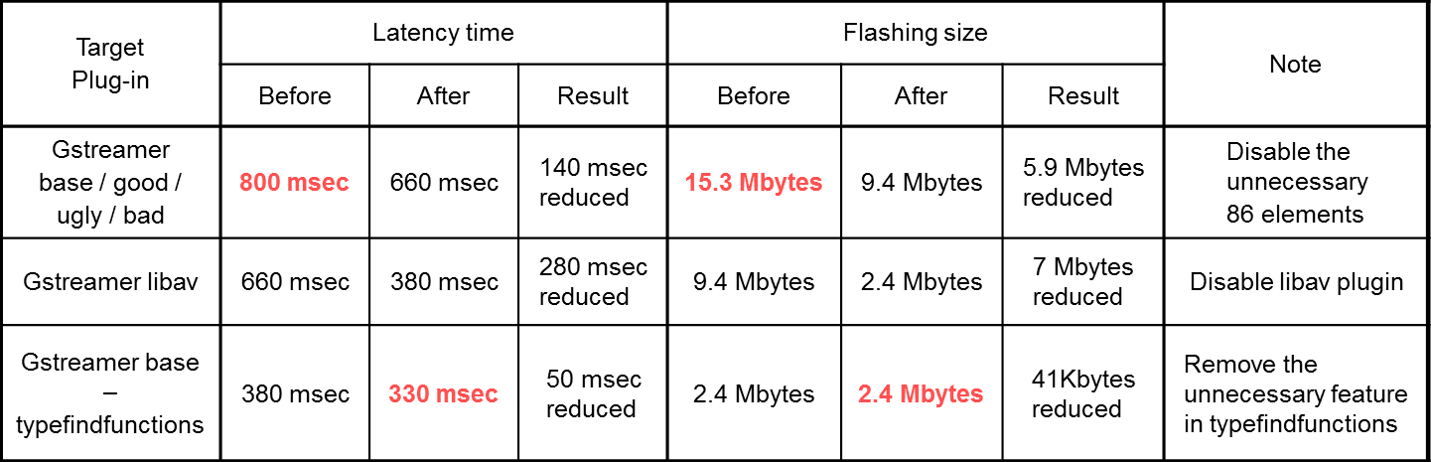
6. Performance Enhancement
Time Latency Analysis
Linux LTTng tool
Key factors to decrease
GStreamer Plugins: unnecessary module and type finder (800ms → 330ms)
PulseAudio 5.0 version upgrade and tuning (650ms → 160ms)
Category | Action Target | Modules
gStreamer | Reduce gStreamer stack and stream buffer | (starfish-pipeline)
Measurement Tool Adoption | Implement LTTng adaption to get performance status | umediaserver, starfish-pipeline, (pulseaudio)
Mediaserver Restructuring | Reduce overhead of resource management | (umediaserver)
Player Restructuring | Implement player with 1 pipeline having output selector | (starfish-pipeline)
Pluseaudio Tunning | Tune queue management to feed encoded streaming | (pulseaudio)
1) an open source tracing framework for Linux
Notes:
Element를 통해 Property를 전달합니다. 그런데 다음 Element에서 Input을 인지하여 연결됩니다.
외부Event에 대한 각 Element가 동기화를 이룹니다.

Slide 28
6. Performance Enhancement
Power Consumption Analysis
CPU Occupation
Linux Perf Tool
Key factors to decrease
uMediaServer : LUNA System Bus
Media Player : I/O interaction, decoder changing
PulseAudio : Mutex based Audio Stream Feeding
uMediaServer
0.60% umediaserver: 671 umediaserver libc-2.17.so [.] 0x00071f34
0.25% umediaserver: 671 umediaserver libyajl.so.1.0.12 [.] 0x000020b8
0.21% umediaserver: 671 umediaserver libc-2.17.so [.] __libc_calloc
0.21% umediaserver: 671 umediaserver libglib-2.0.so.0.3400.3 [.] 0x000338e4
Media Player
2.41% starfish-media-: 9487 starfish-media- libmad.so.0.2.1 [.] synth_full
1.85% starfish-media-: 9487 starfish-media- [kernel.kallsyms] [k] __copy_to_user_std
1.25% starfish-media-: 9487 starfish-media- libmad.so.0.2.1 [.] III_imdct_l
1.23% starfish-media-: 9487 starfish-media- libmad.so.0.2.1 [.] III_decode
0.98% starfish-media-: 9487 starfish-media- libmad.so.0.2.1 [.] dct32
0.65% starfish-media-: 9487 starfish-media- [kernel.kallsyms] [k] _raw_spin_unlock_irqrestore
0.36% starfish-media-: 9487 starfish-media- libmad.so.0.2.1 [.] III_overlap
0.36% starfish-media-: 9487 starfish-media- libgstmad.so [.] gst_mad_handle_frame
0.35% starfish-media-: 9487 starfish-media- libc-2.17.so [.] 0x00071520
0.32% starfish-media-: 9487 starfish-media- libmad.so.0.2.1 [.] III_aliasreduce
0.24% starfish-media-: 9487 starfish-media- libmad.so.0.2.1 [.] fastsdct
0.21% starfish-media-: 9487 starfish-media- libc-2.17.so [.] memcpy
0.19% starfish-media-: 9487 starfish-media- libmad.so.0.2.1 [.] mad_bit_read
0.17% starfish-media-: 9487 starfish-media- libpthread-2.17.so [.] 0x0000a200
PulseAudio
Spin Lock/ Unlock
1.72% pulseaudio: 1013 pulseaudio [kernel.kallsyms] [k] _raw_spin_unlock_irqrestore
0.67% pulseaudio: 1013 pulseaudio [kernel.kallsyms] [k] fget_light
0.46% pulseaudio: 1013 pulseaudio libpulsecommon-5.0.so [.] 0x00034b06
0.36% pulseaudio: 1013 pulseaudio [kernel.kallsyms] [k] _raw_spin_unlock_irq
0.36% pulseaudio: 1013 pulseaudio [kernel.kallsyms] [k] fput
0.31% pulseaudio: 1013 pulseaudio [kernel.kallsyms] [k] do_sys_poll
0.31% pulseaudio: 1013 pulseaudio [kernel.kallsyms] [k] sub_preempt_count
0.22% pulseaudio: 1013 pulseaudio libpulsecore-5.0.so [.] pa_sconv_s32le_to_s16ne
0.20% pulseaudio: 1013 pulseaudio libpulsecore-5.0.so [.] 0x00022dca
0.17% pulseaudio: 1013 pulseaudio [kernel.kallsyms] [k] eventfd_poll
Notes:
Element를 통해 Property를 전달합니다. 그런데 다음 Element에서 Input을 인지하여 연결됩니다.
외부Event에 대한 각 Element가 동기화를 이룹니다.

Slide 29
6. Performance Enhancement
Power Consumption Activities
MP3 playback via BT
Tasks
http://collab.lge.com/main/download/attachments/198476541/BT+MP3+Power+Consumption+Detail+Activities_20141130.xlsx
Category | Contents
Audio Decoder | - Adopt Android MP3 Decoder - Modify 16bit audio output
 | - Integer based Vorbis Decoder - Modify 16bit audio output
 | - Integrate HW OMX AAC Decoder - Modify 16bit audio output
 | - Remove Floating Point calculation
PulseAudio | - UIPC_Available making additional spin lock/unlock was removed
 | - Feeding buffer to BSA increase from 20KByte to 200KByte
uMediaServer | - System Event Period Decrease from 200msec to 400msec
 | - Remove PmLog code
Audiod | - When it goes into the sleep mode, NACK response fails to retry to connect so frequent was fixed

Slide 30
6. Performance Enhancement
Power Consumption Result
28.57mA for MP3 Playback which is more than 0.57mA compared to Android KitKat as of Nov 30th
Target : Total consumption is 65mA, MP3 playback is 28mA.
Total
Multimedia
Before/After CPU IDLE Enhancement
+70mA
BT
+7.5mA

Slide 31
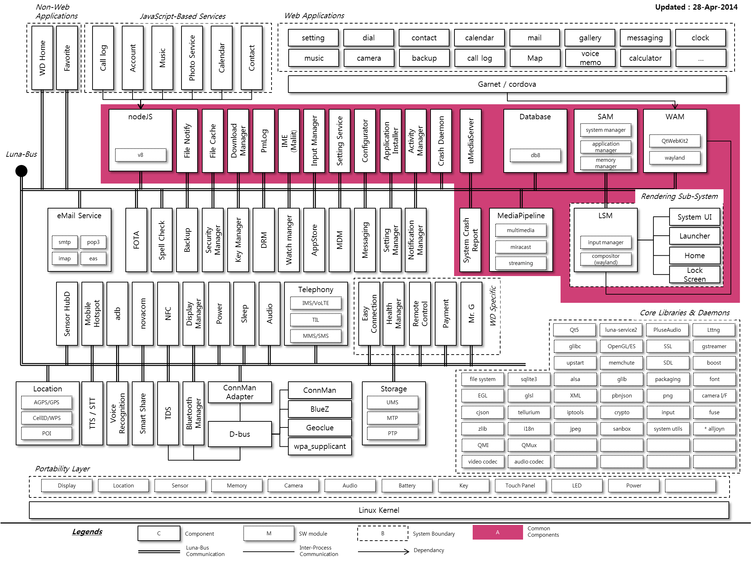
Appendix
webOS Wearable Architecture

Slide 32
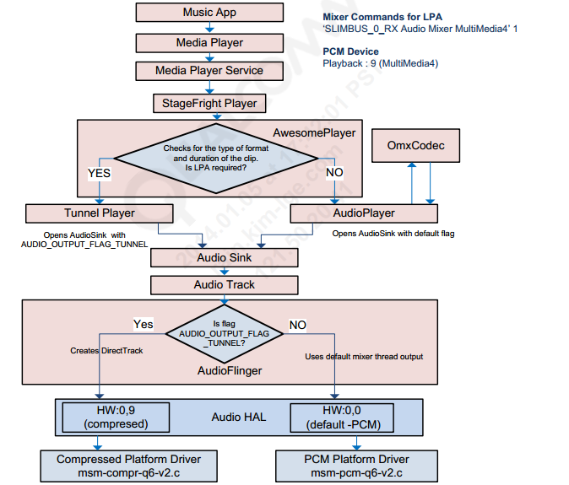
Appendix
Android KitKat Design

Slide 33
Appendix
Audio System
PuluseAudio handles Audio Stream
DASS for TV handle TV and Media audio Stream directly
Open webOS
webOS Mobile
webOS TV
Audiod
Audiod
Audiod
DASS
PulseAudio
PulseAudio
PulseAudio
ALSA
ALSA
ALSA
BSP Interface
<UCM>
HW Driver
HW Driver
HW Driver

